Slide 1
Sst Project
By Avanish Murkute
Class 6th B
Roll no. 12

Slide 2
Why did people travelled to India in ancient times.Describe the routes used to reach India and its favorable geographical features.

Slide 3
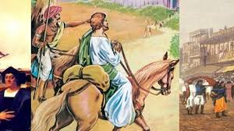
Why did many people travelled to India in ancient times?
People traveled to India from various parts of the world in ancient times for several reasons: Trade and Commerce: India was known for its wealth and resources, including spices, textiles, and precious stones

Slide 4
How did many people travelled to India in ancient times?
In ancient India the major means on land transportation we're Chariots which were mostly driven by horses for the royal families of Kings and ministers while the poor Farmers used bulls and donkeys.

Slide 5
Explain at least four motivations behind travelling to India in ancient times.

Slide 6
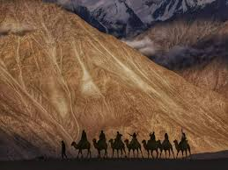
Here are some points behind travelling to India in ancient times?
Spiritual and Religious Quest. India was the birthplace of Buddhism and Hinduism, two of the world's major religions. ...
Intellectual Curiosity and Scholarship. ...
Economic and Trade Interests. ...
Diplomatic and Political Interests. ...
Cultural and Anthropological Exploration.

Slide 7
For what reasons did travel occurs in ancient times?
In search of livelihood. To escape from natural disasters like floods or drought. Religious teachers travelled from one place to another to offer instructions and advice on religion. For adventurous purposes and exploring new and distant places

Slide 8
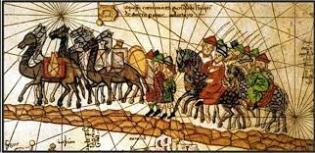
What motivated people to travel in ancient times?
During ancient times people travelled out of their places of resi- dence for various reasons, mainly for migrant and military purposes. Other drivers included trade, spectacle games and festivity attendance, and for religious reasons, such as the case of tirthayatra (pilgrimage) in India.

Slide 9
What were the routes to reach India in ancient times?

Slide 10
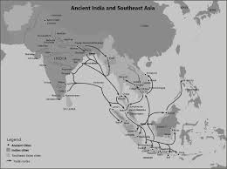
What was the route to India ?
Vasco da Gama, a Portuguese explorer, is credited with discovering the sea route to India. His landmark journey took place in 1497, when he sailed around the southern tip of Africa, the Cape of Good Hope, and then across the Indian Ocean to reach the port of Calicut (now Kozhikode) on India's west coast.

Slide 11

Thank you and hope this project make your mind interesting.

